Slide 1
Project Sarpa
The Ultimate Two-Player Snake Game

Slide 2
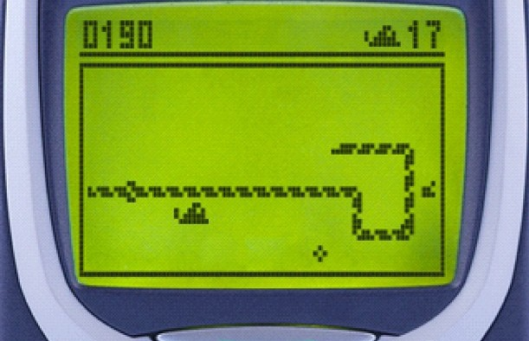
INTRODUCTION
A single player simple snake game is one of the basic games we have ever enjoyed in our java based mobile phones. This game fulfills all the limitations of the traditional snake game in context to sound, graphics, levels ,etc.

Slide 3
OBJECTIVES
We started off with some general objectives:
To create a snake game that will have all the functionality of traditional snake games.
Enhance graphics, sound, levels and user interface.
Introduce dual player functionality in the game that will allow two players to play the game throughout the same key board.

Slide 4
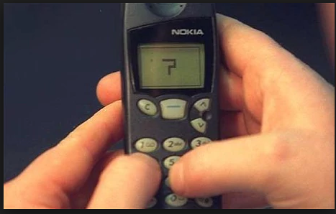

CASE STUDY
1. Traditional Snake game
Snake is the common name for a video game concept where the player maneuvers a line which grows in length, with the line itself being a primary obstacle.
After a variant was preloaded on Nokia mobile phones in 1998, there was a resurgence of interest in the snake concept as it found a larger audience.
The game play consists of a player who controls a dot, square, or object on a bordered plane.

Slide 5
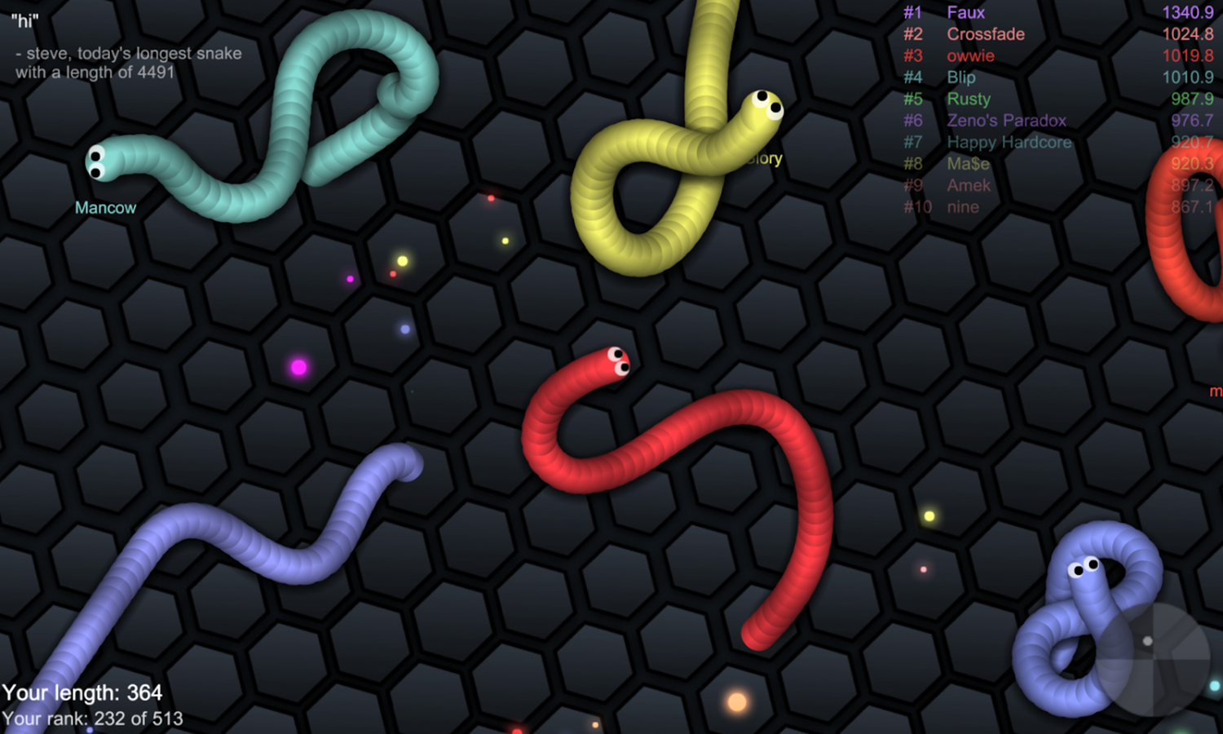
CASE STUDY
2. Slither.io
It is a massively multiplayer browser game developed by Steve Howse
The objective of the game is to control and move a snake around a colored area, eat pellets to gain mass, defeat and consume other players to grow the biggest and longest in the game.
Pellets also spawn from other snake avatars.
There is a border that confines avatars within the circular game board.

Slide 6
INITIAL DESIGN
Design
A window that has GUI that has three options: Play, Help And Quit.
A next window that consists of instructions.
Another window where actual game is played.
Two snakes of different color.
A food to increase length.
Obstacles to kill snakes.
Competitive three levels.
In the end, a new window that displays the winner.

Slide 7
PROGRAM DEVELOPMENT
Primary Development
Window Making, Fitting One Snake And Food.
Making Two Snakes Of Different Variables Alongside Bugs.
Creating GUI And Sound.
Three Levels.
Winner Window Displaying And Creating Instructions.
Secondary Development
Mouse Detection.

Slide 8
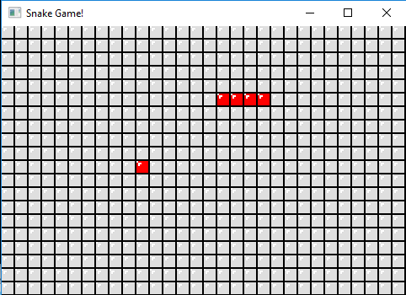
PROGRAM DEVELOPMENT
Window Making, Fitting One Snake And Food.

Slide 9
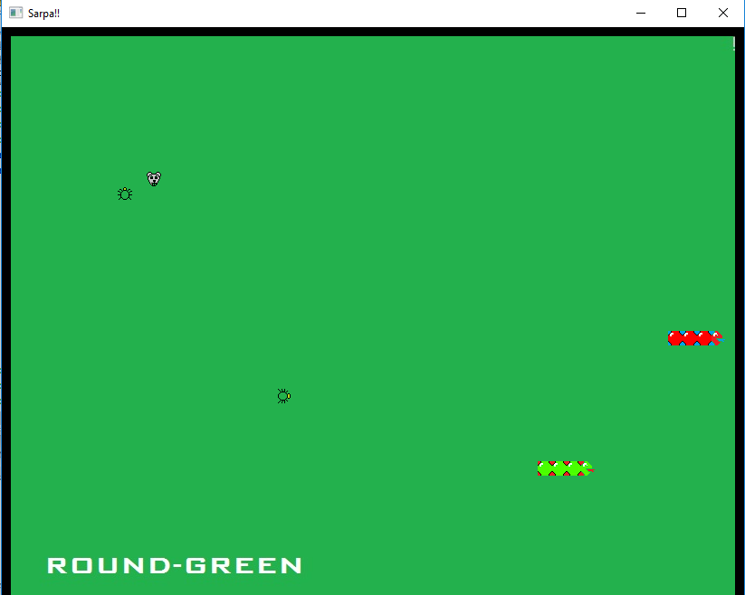
PROGRAM DEVELOPMENT
Making Two Snakes Of Different Variables Alongside Bugs.

Slide 10
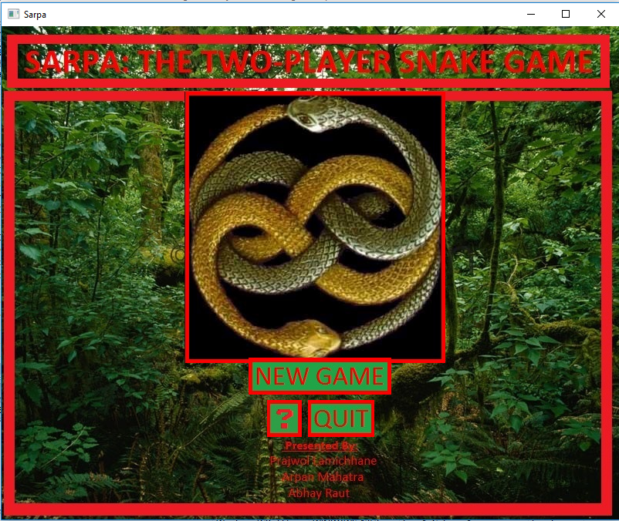
PROGRAM DEVELOPMENT
Creating GUI And Sound

Slide 11
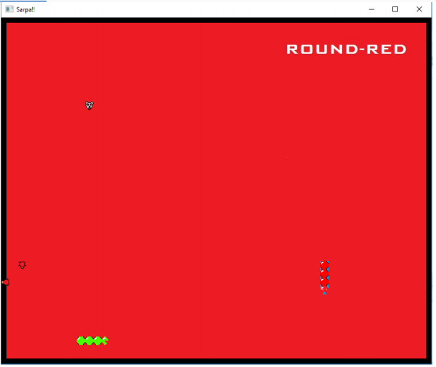
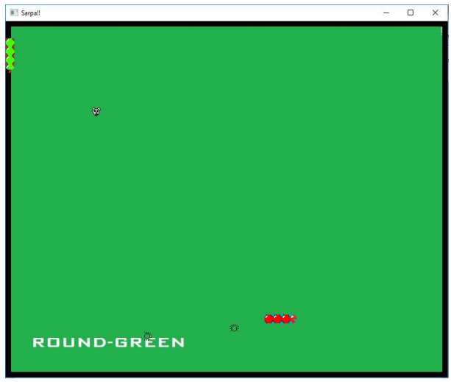
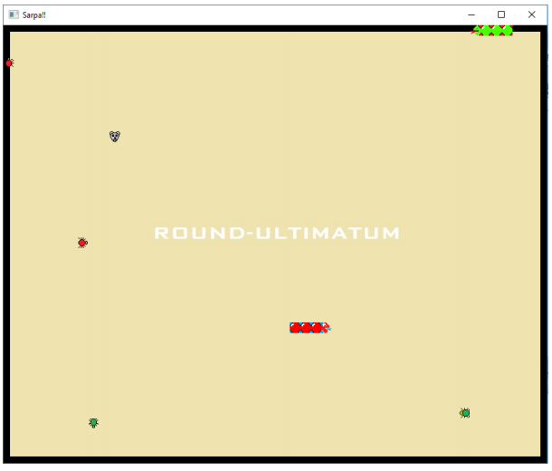
PROGRAM DEVELOPMENT
Three Levels

Slide 12
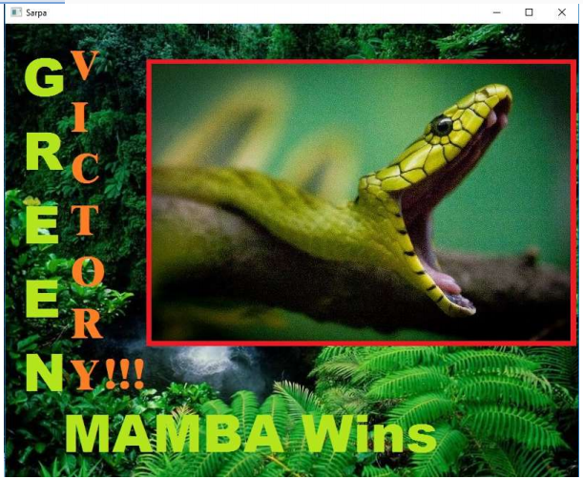
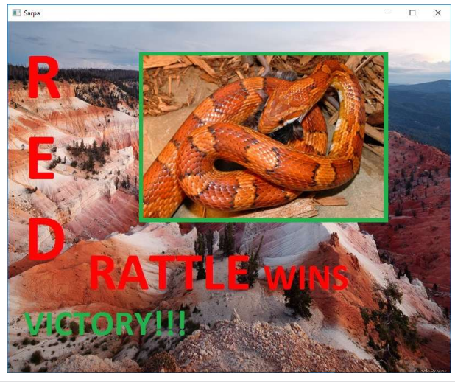
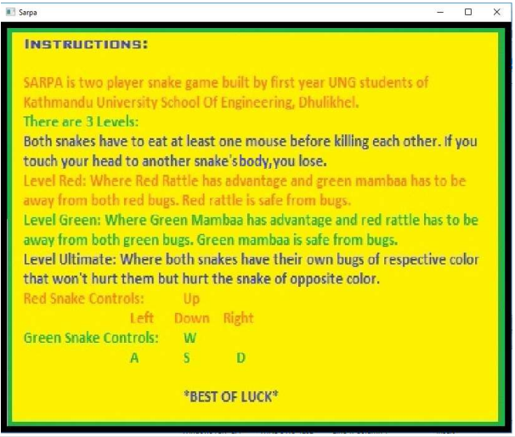
PROGRAM DEVELOPMENT
Winner Window Displaying And Creating Instructions
And, Mouse Detection

Slide 13
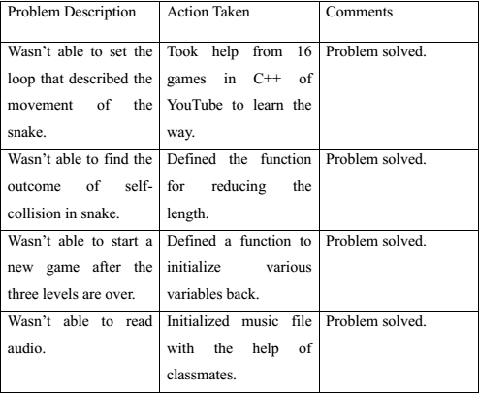
TESTING AND DEBUGGING

Slide 14
IMPLEMENTATION
Entertainment purpose
Socialization purpose
For future reference

Slide 15
TOOLS USED
CodeBlocks
MS Paint
Atom text editor

Slide 16
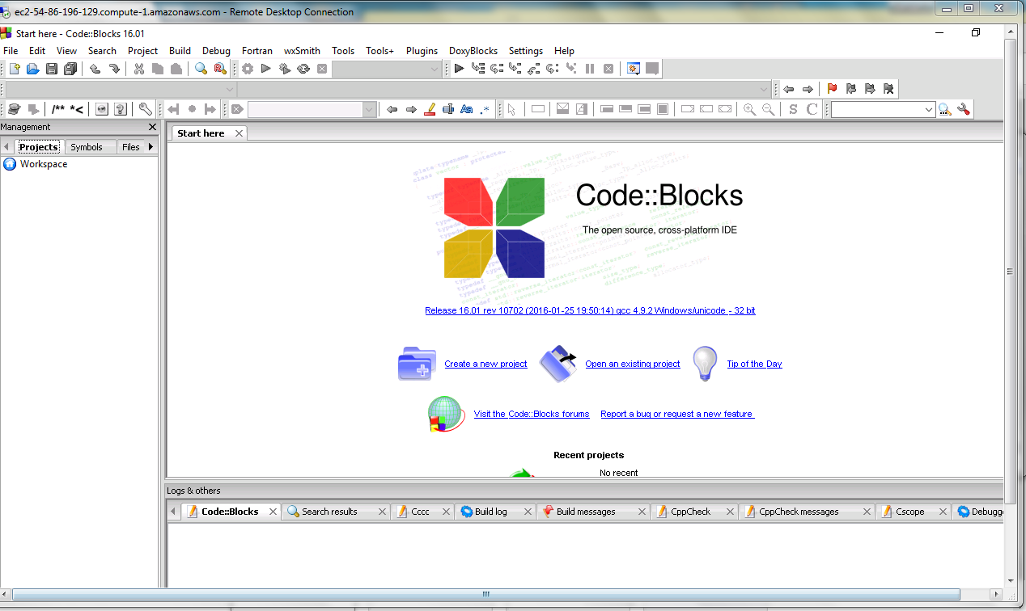
TOOLS USED
CodeBlocks

Slide 17
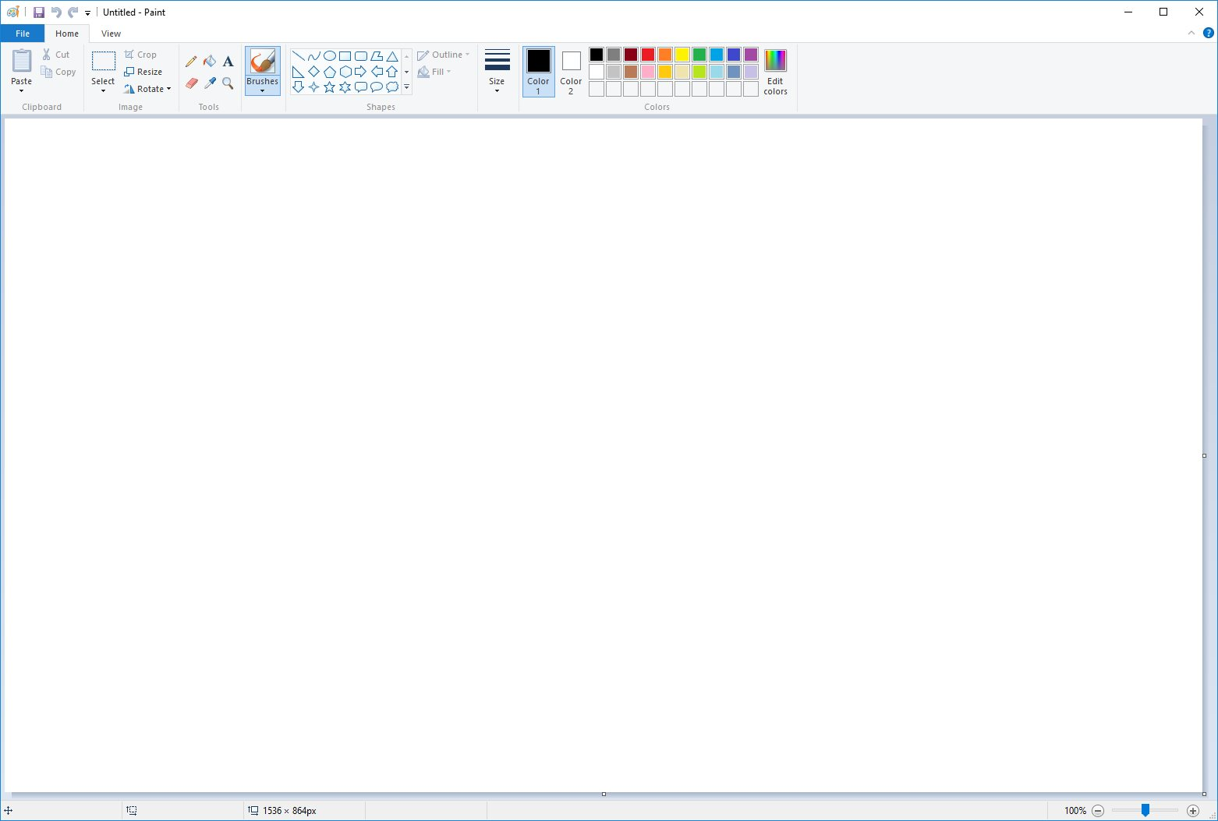
TOOLS USED
MS Paint

Slide 18
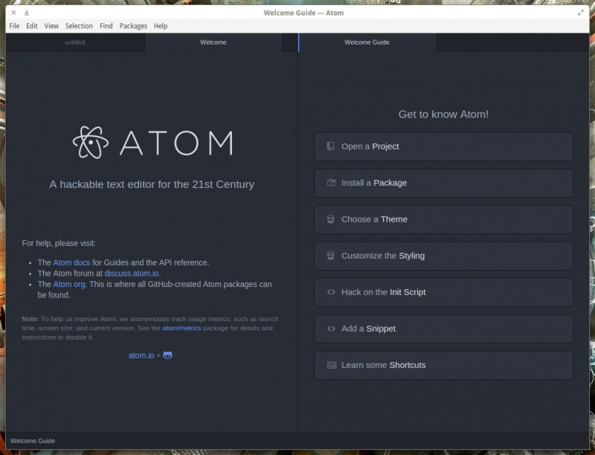
Atom

Slide 19
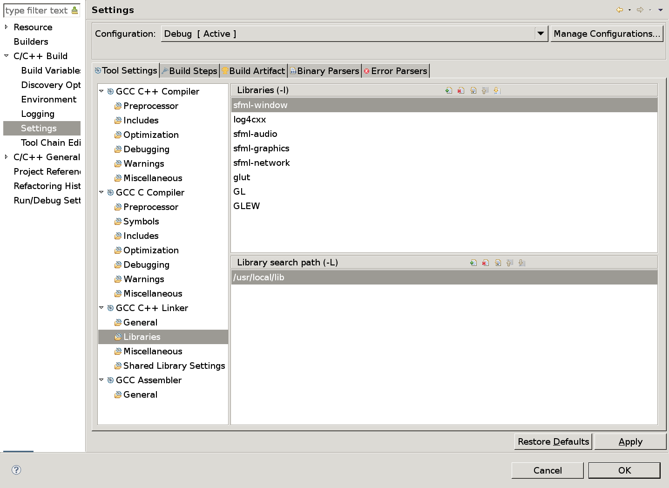
LIBRARIES USED
SFML

Slide 20
LIMITATIONS AND FUTURE PLANS
LIMITATIONS:
User can’t choose their snake’s avatar
User can’t change the control functionalities.
There is no provision of playing multiplayer by the use of internet or hotspot.
Also, the idea of recording history records was unsuccessful.

Slide 21
LIMITATIONS AND FUTURE PLANS
Further Development
Updating the game play, by adding some extra features like file handling to save the history records, adding pause feature in the game while alsoi ncreasing some graphical elements.
We have thought of adding some extra snake avatars as per the likeness of the user.
We have also thought of establishing the online playing through internet hence making our project ideally suitable to the real gaming world.

Slide 22
CONCLUSIONS
This project game successfully provides a two player experience never found in previous ‘Snake’ games. It also provides three levels with advantages on either sides. However, the project can be improved upon with multiplayer mode, high-score management, controls and choosing different avatars for snakes to add on the user experience. Any recommendations from the users to make the game more entertaining are highly encouraged.

Slide 23
REFERENCES
www.sfml-dev.org
www.github.com
www.gamecodeschool.com
www.stackoverflow.com
www.cplusplus.com
www.wikipedia.org/wiki/Snake_(video_game)
www.peko-step.com/en/tool/alphachannel_en.html

Slide 24
THANK YOU!

